Slide 1
Build a Better Buyer Consultation
Notes:
KWFR16
Headline Title and Sub-Title.
Speakers Name.

Slide 2
Delivering Steller Buyer Consultations
Setting the Stage for Success
Explaining the Home-Buying Process
Conducting a Needs Analysis
Defining Expectations
Getting an Exclusivity Agreement Signed
Notes:
Stellar buyer consultations are those that achieve:
A foundation of trust between you and the buyers.
Clarity about the steps in the home-buying process.
A comprehensive understanding of what is important to the buyers and what their goals are.
A clear understanding about what you can expect from each other during and after the process.
An agreement to work together.

Slide 3
Why Do We Want to do a Buyers Consultation?
Builds a deeper relationship with the client and allows us to demonstrate value
Very efficient investment of time for both parties. It saves time, money and gives both parties a better peace of mind
No distraction for either side so we can visually demonstrate Trend etc. in a protected environment
Allows us to set an agenda, expectations and a path forward

Slide 4
Convert the Lead/Call
Who is it all about?
What’s their favorite subject?
Don’t sell and tell about YOU. 70-30 rule
Close for buyer consult appt. Sell value by speaking about the mortgage process
Congratulations! You have an appointment! Confirm 24 hours before the appt

Slide 5
Setting the Stage for Success
Use a script:
“Before we get started, I would like to share my/our team mission with you. My/Our mission is to help you achieve your goals and exceed your expectations. By doing this I/we hope you would never hesitate to refer me/us to your friends, family, or coworkers. Therefore, at the end of our meeting today, one of three things will happen …”

Slide 6
Setting the Stage for Success
“One: You will understand all the benefits I/my team can provide to you and you will choose to hire me/us and that would be great!”
“Two: You may not understand all the benefits I/my team can provide to you and you may choose not to hire me/us and, to be quite honest, that wouldn’t be so great.”
“Three: I/We may choose not to represent you in the purchase of your new home.”
“Would that be a fair assessment?” (pause for reaction)

Slide 7
Setting the Stage for Success
“Let me explain why I would say that. Remember, my/our mission is to help you achieve your goals and exceed your expectations. Well, if at any time during our meeting today I feel I/we cannot achieve your goals or exceed your expectations, I would rather turn you down now than let you down later, and we can part as friends. Does that sound fair to you?”
“Great, let’s get started!”

Slide 8
Setting the Stage for Success
Walk through state disclosures.
Have everything prepared in advance
Make sure you have coloring books
2 ears and one mouth 70/30 Rule
Drinks and snacks?
Don’t ask them to sign any documents … yet.

Slide 9
Explaining the Home-Buying Process
Agenda
Overview
Research Process
Properties
Market Conditions / Inventory
The Offer
The Contract
Negotiation Process
Contract-to-Close Process

Slide 10
1. Overview
Ask permission.
Explain the steps.
Help buyers understand the value an agent brings to the process and how it differs from Zillow/Trulia etc.
Why we do buyer consults?
RE Agent versus RE consultants

Slide 11
2. Research Process
Explain the research process.
Research sources:
Multiple Listing Service (MLS)
For sale by owner (FSBO) houses
New construction houses
Withdrawns and expireds
Short Sales and Foreclosures
Auto emails
Notes:
Explain how long the research process might take (and why).
Describe the different research sources you will use:
Multiple Listing Service (MLS)
For Sale By Owner (FSBO) houses
New construction houses

Slide 12
3. Properties
Set up for success.
Determine average number of homes a buyer typically tours before making a decision. (5 to 10)
What would the buyer do if the first house met all of their criteria?
Notes:
Set them up for success.
Average number of homes a buyer typically tours before making a decision.
What would the buyer do if the first house meets all of their criteria?

Slide 13
4. Market Conditions / Inventory
Share local market conditions.
Explain buyer’s market vs. seller’s market.
Use the statistics to explain the market.
Be the interpreter, not the creator, of the market.
Educate. Don’t sell and tell.
Watch their eyes, are they glazing over?
Notes:
Share local market conditions.
Explain buyer’s market vs. seller’s market.
Educate on what percentage of (or over) asking price sellers are typically receiving.

Slide 14
5. The Offer
Discuss how much they are willing to pay.
Explain the process of determining / making an offer.
Comparative Market Analysis (CMA)
Types of contractual contingencies
Prepare for multiple offer situations.
Explain what you can control and what you can’t.
1/3 of homes sell in 14 days, 1/3 at DOM and 1/3 after
Notes:
Discuss how much they are willing to pay.
Explain the process of determining/making an offer.
Comparative Market Analysis (CMA).
Types of contractual contingencies.
Prepare for multiple offer situations.

Slide 15
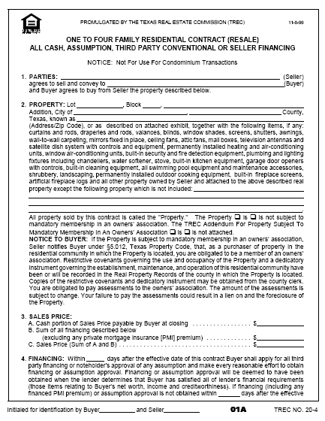
6. The Contract
Highlight key points in contract documents.
Provide sample documents.
Ask buyers to review documents.
Explain which standard contingencies will be included.
Encourage questions before writing an offer.
Notes:
Walk through a sample contract document, but ask buyers to take information home with them to review and formulate additional questions.
Standard contract contingencies might include:
Home inspection
Seller’s disclosure
Financial contingencies

Slide 16
7. Negotiation Process
Explain your role.
Explain their role.
Explain time is of the essence.
Reiterate responsibilities of a buyer agent.
Recap the 1/3 rules again
Are they VA or FHA and why that matters, sellers assist
Notes:
Explain your role in the negotiation process.
Reiterate responsibilities of a buyer’s agent.

Slide 17
Conducting a Needs Analysis
The Tens Exercise
Use a script to ask about the transaction:
“On a scale of 1 to 10, with 1 being ‘not very good’ and 10 being ‘it’s awesome, it’s a great experience,’ what one thing has to happen for this transaction or process to be a 10 for you?” It is all about referrals!
Notes:
Ask what would make the transaction a 10+ and a 10++.

Slide 18
Conducting a Need Analysis
Always Go Three Deep!
Why is _______ important to you?
Describe for me what you mean by ________?
What about having a large yard is important to you? I like to garden.
What is it about gardening that is important to you? I like to spend time outdoors relaxing.
What is important to you about feeling more relaxed? When I am relaxed, I can spend more quality time with my wife and son.
FAMILY
Notes:
Your goal is to identify the buyer’s wants, needs, and values. Needs are the things that the buyers must have in order for a transaction to occur. Wants are the things the buyer would like to have, but may not be absolutely essential. Finally, values are the core motivations that drive buyers’ wants and needs.
Buyers often readily share wants and needs. Understanding their values is much more difficult. However, since people generally make decision that are aligned with their core values, uncovering these is critical for success.
Determining your buyers’ core values is a process. By continuing to dig deeper through their needs and wants, you ultimately uncover their values. Begin by asking the following question: “What about ___ is important to you?”
Spiral graphic is animated and will zoom in automatically just after slide opens.
What about having a large yard is important to you?
I like to garden.
What is it about gardening that is important to you?
I like to spend time outdoors relaxing.
What is important to you about feeling more relaxed?
When I am relaxed, I can spend more quality time with my wife and son.
CORE VALUE? FAMILY

Slide 19
Conducting a Needs Analysis
“What are the top ten things you want in a home?”
“Go deep on each response, why, why, why is that important to you?”
“Let’s prioritize the things you wrote down in order from most important to least important.”

Slide 20
Getting an Exclusivity Agreement Signed
Use a script and move straight to the Buyer Agent Exclusive (representation) document:
“Ready to get started finding that dream home?”
Pull out your Agreement of Loyalty and begin filling it in!
Notes:
Use a script and move straight to the buyer’s agent exclusivity (representation) document:
“I feel good about this process. How do you feel?...Great. Then let’s move forward with this relationship.”
Complete the document with their participation.
Put exclusivity language into layman’s terms.
“It’s kind of like we’re engaged…”
Present document for their signature.

Slide 21
Ideas Into Action!
Develop powerful scripts to help set the stage for success.
Create a Home-Buying Packet to help you explain the steps in the process.
Practice probing to identify needs, wants, and values.
Clarify expectations!
Learn how to get an exclusivity agreement signed.
Set stage for a referral based business

Slide 22
Action Plan
List at least ONE action you will take as a result of what you’ve learned.
……………………………………………………………..
…………………………………………………………......
…………………………………………………………......

Slide 23
411, CGI and My Tracker
Session #2

Slide 24
The 411 and My Tracker Walk Through
What is a 411? Big Rocks. A goal without a plan is not a good plan. Annual Goals vs. Monthly Goals and Weekly Goals
My KW.com and go to Education Tab, it is the 5th drop down called My Tracker. How to put in your daily activities

Slide 25
My Tracker Snapshot Below

Slide 26
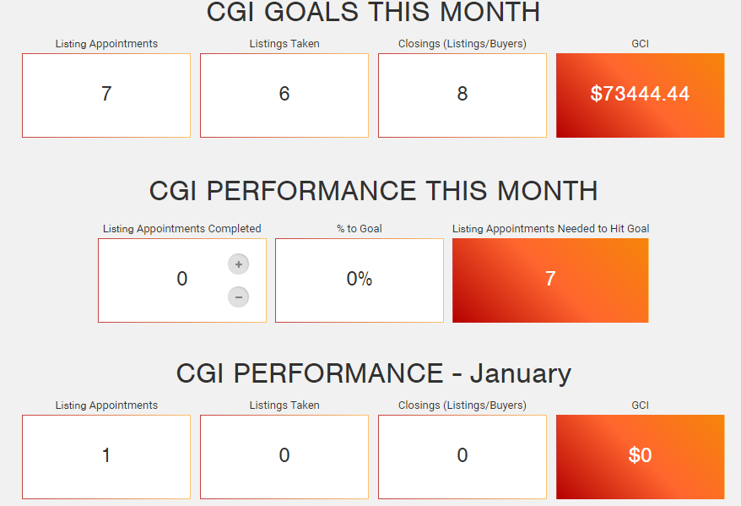
CGI aka Career Growth Initiative Calculator
Excellent link for a 5:54 video

Slide 27
CGI
My KW to Education to KW Connect to Growth to Career Growth Initiative
Works well with both the 411 and My Tracker
Populates our KW Dashboard
Update Goals in view full GCI calculator

